Slide 1
Introduction to Computing
OPERATING SYSTEM (Part-II)

Slide 2
A Quick Recap
Operating System
Functionalities of OS
Types of OS

Slide 3
Process in Operating System
Operating system executes variety of programs.
A process is defined as a program in execution.
Each process may further create multiple child processes adding into the job pool.
Each process during its execution may go through several states.

Slide 4
States of a Process
There are multiple states of process based on their status and where they reside in system.
Once a process is created it may go through these underlying states.
  New
  Ready
  Running
  Waiting/Blocked
  Suspended Wait
  Suspended Ready
  Completed/Terminated

Slide 5
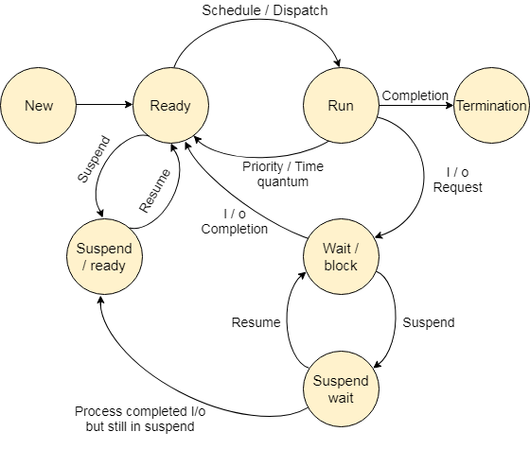
Execution of Process
States of Process & their transition is graphically represented as…

Slide 6
New – Creation of Process

Slide 7
Ready – Loading Process in Main Memory

Slide 8
Running – Execution of Process by CPU

Slide 9
Ready – After the lapse of CPU burst

Slide 10
Running – Execution of Process by CPU leading to ……

Slide 11
Wait –I/O request during execution

Slide 12
Ready – Route to Ready after I/O completion

Slide 13
Running – Route to running at its turn to exec

Slide 14
Termination – Process is completed

Slide 15
Lets consider a scenario!!!
The previous scenario worked by requesting for I/O and is dispatched to ready after I/O completion.
What if the I/O is not available and the request is not fulfilled.
After I/O request is made process is in Wait/blocked state. The process will remain in the state unless I/O request is not completed. The process will remain in Memory, which may occupy space for upcoming programs. There comes the virtual memory

Slide 16
Virtual Memory
An example of memory management technique to compensate the shortage of main memory.
Dedicated amount of memory in secondary storage allocated by OS.
Used to transfer data when the main memory is not sufficient enough.

Slide 17
Suspend wait – Process is swapped out

Slide 18
Wait – Process may swap in at previous state

Slide 19
Suspend Ready – I/O completed but swapped out

Slide 20
Lets consider another scenario!!!
The previous scenario consisted of process requesting for I/O and is swapped into the secondary storage (virtual memory). After completion of I/O if it remains suspended, it moves to suspended ready. If the I/O is still not completed by process needs to be swapped back in, it will go to wait.
What if the process that are in ready state, need to be swapped out of the memory due to low space
They are swapped out into the suspended ready state.

Slide 21
Ready – Awaiting CPU execution

Slide 22
Suspended Ready – swapped out of main memory

Slide 23
Processes & memory
Main Memory
Secondary Memory

Slide 24
Schedulers
Long Term scheduler(or job scheduler) – selects which processes should be brought into the ready queue
Short-term scheduler(or CPU scheduler) –selects which process should be executed next and allocates CPU
  Looking at the algorithms which schedule the tasks for CPU

Slide 25
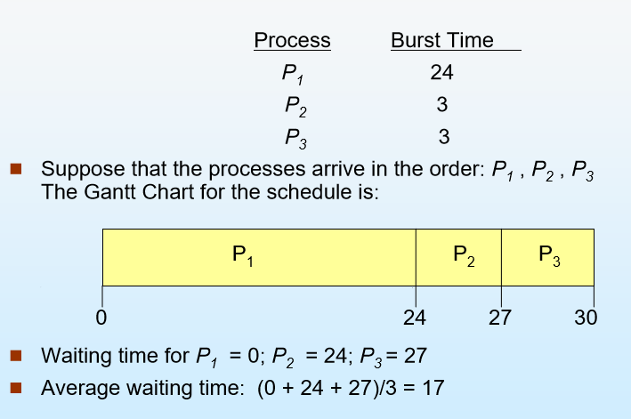
First Come First Serve - FCFS

Slide 26
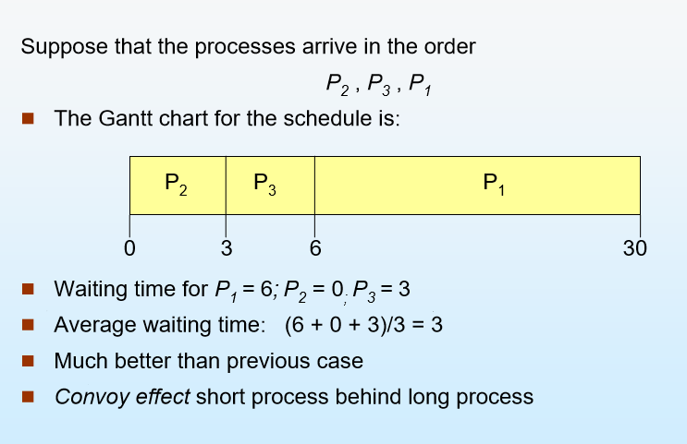
First Come First Serve - FCFS

Slide 27
Shortest Job First- SJF
Associate with each process the length of its next CPU burst. Use these lengths to schedule the process with the shortest time.
Two schemes: non-preemptive –once CPU given to the process it cannot be preempted until completes its CPU burst
Preemptive – if a new process arrives with CPU burst length less than remaining time of current executing process, preempt. This scheme is know as the Shortest-Remaining-Time-First (SRTF)

Slide 28
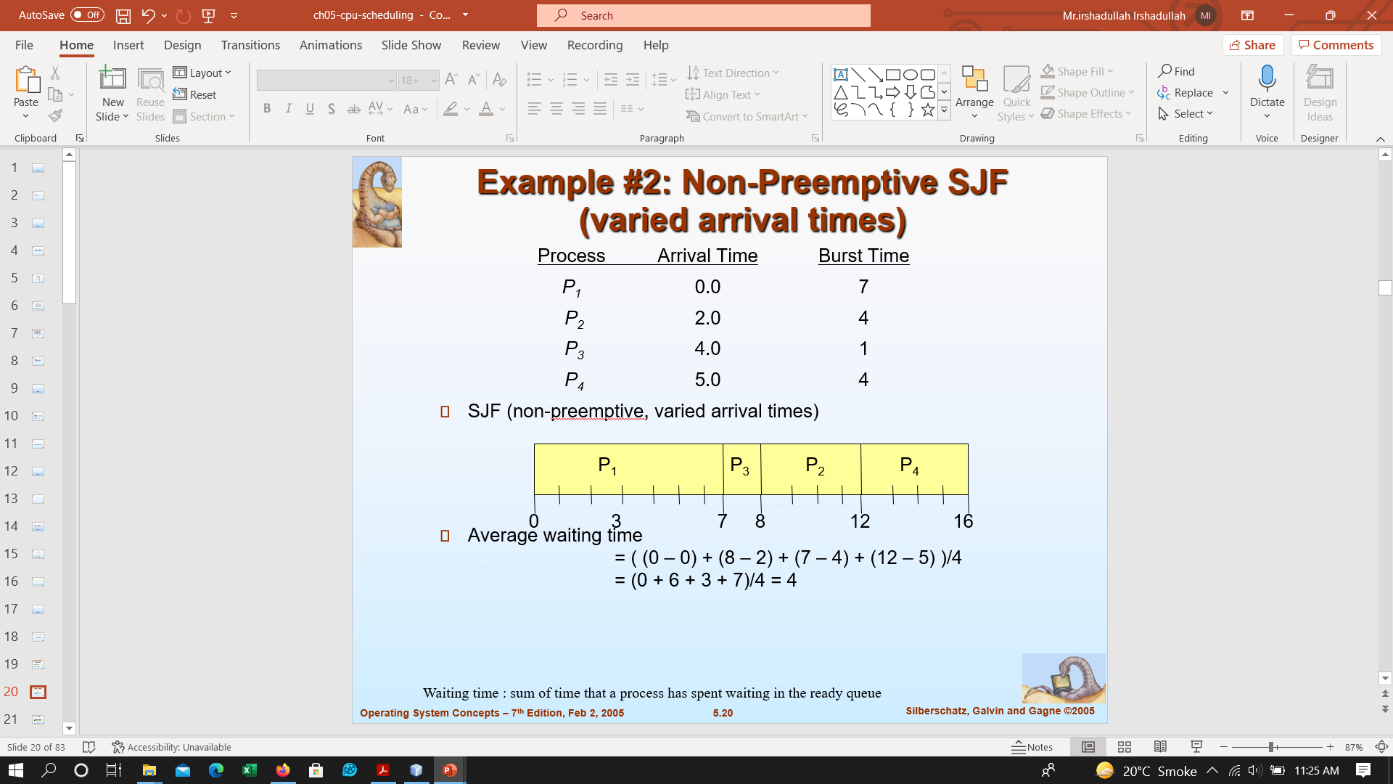
Shortest Job First- SJF Non-Preemptive

Slide 29
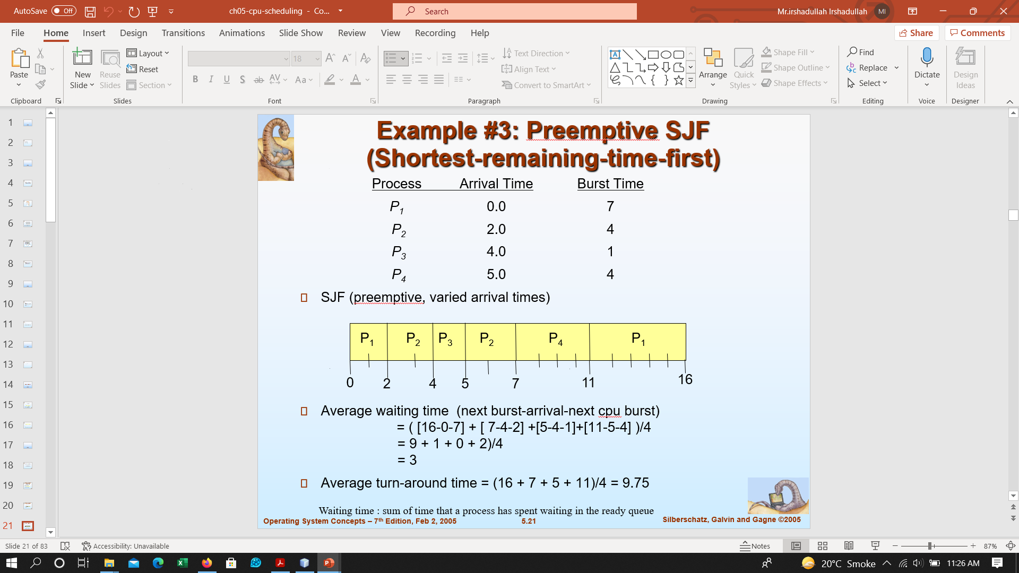
Shortest Job First- SJF Preemptive

Slide 30
Round Robbin
Each process gets a small unit of CPU time (time quantum), usually 10-100 milliseconds. After this time has elapsed, the process is preempted and added to the end of the ready queue.
If there are n-processes in the ready queue and the time quantum is q, then each process gets 1/n of the CPU time in chunks of at most q time units at once. No process waits more than (n-1)q time units

Slide 31
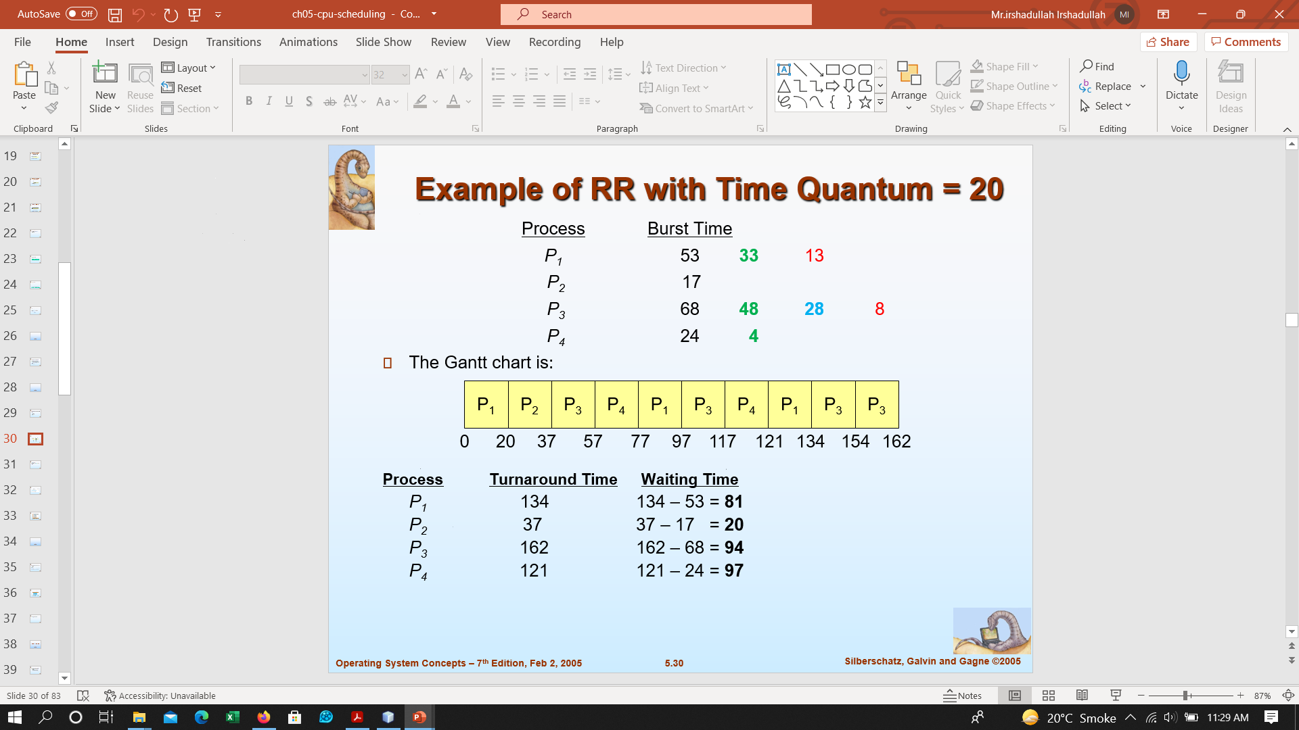
Round Robbin
Average waiting time = 73
Average waiting time for SJF = 38

